Slide 1
Data Structures Workshop
Day 7

Slide 2
Workshop Outline
Big O notation
Bubble Sort

Slide 3
Big O notation

Slide 4
Big O notation
A mathematical notion used to describe the cost of an algorithm​
Used to define runtime complexity and space complexity​
We won't focus too much on space complexity​
For O(N) it used to describe worst case. In discrete you will learn other O notations for best case and average.

Slide 5
Why Learn It​
You need to for the class duh?​
You will maybe talk more about it in discrete class​
You will need to somewhat understand big O for coding interviews as some will ask about Big O for your code or to solve in Big O of something time/space​

Slide 6
Time Complexity from Best to Worst​
O(1): Constant time. Accessing array data, no matter the size of array. (Best)​
O(log n): Logarithmic time. Divide and conquer methods, splitting arrays (Very Good)​
O(n): Linear time. Time complexity grows proportionate to input size (Good)​
O(nlogn): Linearithmic Time. Divide and Conquer methods of O(n) steps (Worst and Best)​
O(n^2 ): Quadratic Time. Nested loops, traversing, 2D arrays, sorting (Not good)​
O(2^n ): Exponential Time. Growth rates doubles with each addition to input (Very bad)​
O(n!): Factorial Time. Example would be a Bogsort. (Extremely Bad) ​

Slide 7
O(n) Continued​
For the rest of the class you will primarily focus on Time complexity rather than space complexity.​
In this case O(n) n in O(n) will refer to any amount of numbers of inputs.​
Time complexity tend to be reduced down to ones listed on previous slides
Ex: O(7) -> O(1). O(3x)-> O(x) and O(3x^2 +5x + 4) -> O(n^2)​
O(1) means no matter any amount of input weather 1 or 1000. There will always be the same amount of actions​

Slide 8
Examples

Slide 9
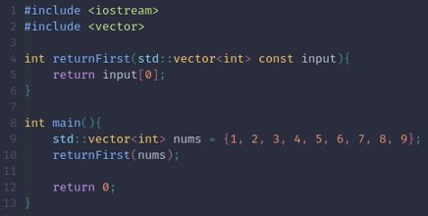
Example of O(1)​
In this case no matter the amount of inputs (number of values in the vector) you are only printing out 1 value​
This is truly O(1);​
If this would print out the first value 3 times for example. Technically it would be O(3) but again it would get reduced to O(1)​
​

Slide 10
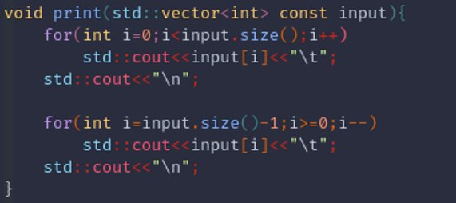
Example of O(n)​
Here you have variable i relying on input. Since you traverse i through input.size(). i relies on the input size linearly its O(n) for the first loop and O(n) for the second. Both together come as O(2n) counting the 2 random couts O(2n+2) but again it gets reduced down to O(n)​

Slide 11
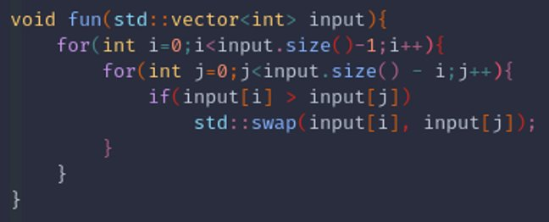
Your turn: What is this code time complexity​
O(n^2)

Slide 12
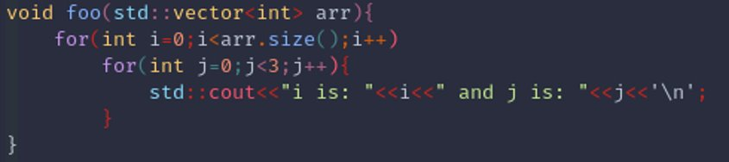
Beware of For loops. Not all for loops are O(n)​
I saw something like this on the exam. THIS IS NOT O(n^2), LOOK AT THE NESTED FOR LOOP​
IT IS O(N)

Slide 13
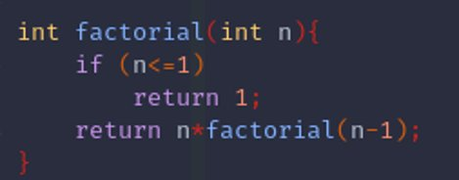
Not all O(n)s come from loops​

Slide 14
Its pretty much pattern recognition​
Mostly you can get away with seeing certain pattern(s) and saying an O(n) that relates to that problem​
Pretty much everything here that is applied to time complexity can be applied to space complexity​

Slide 15
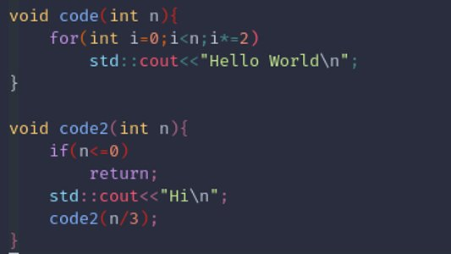
O(logn)
O(logn)
O(logn)

Slide 16
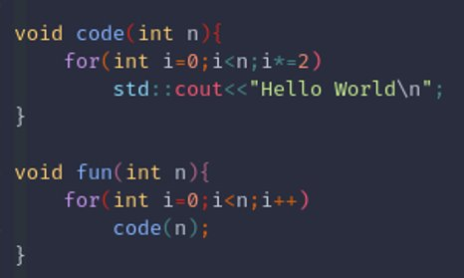
O(nlogn)
IMAGINE A FUNCTION THAT CALLS BOTH OF THE FUNCTION
O(nlogn)

Slide 17
Bubble Sort​

Slide 18

Bubble Sort

Slide 19
Characteristics of Bubble Sort​
Composed of 2 for loops (nested for loop)​
First one iterates n number of times, where n is the size of the array​
Second one iterates through the array (n times), decreasing 1 for each iteration​
Check adjacent elements, swap if they are out of order​
For every pass, the last elements will be sorted first​
Because you stop at n - i – 1​

Slide 20
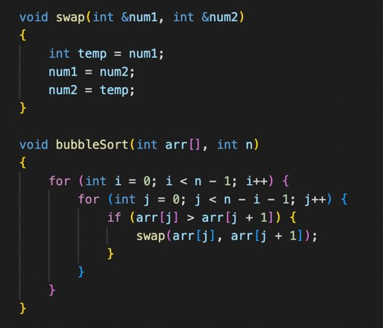
Bubble sort code​

Slide 21
Bubble Sort Continued​
What is the time complexity?​
What is the worst case scenario? Complexity?​
Average case?​
Best case?​
How can we optimize bubble sort to reach O(n)?​

Slide 22
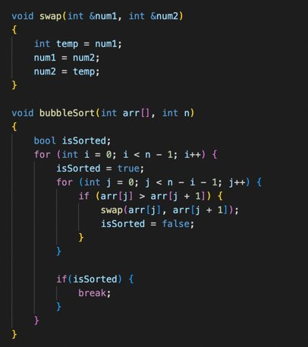
More Efficient Bubble Sort​
Ex:
5,1,4,2,8,9
Pass 1(sorted = true)
1,5,4,2,8,9
1,4,5,2,8,9
1,4,2,5,8,9
Sorted = FALSE
Pass 2(sorted = true)
1,2,4,5,8,9
1,2,4,5,8,9
1,2,4,5,8,9
1,2,4,5,8,9
Sorted = FALSE
Pass 3(sorted = true)
Sorted = True
Break;
O(N)

